Slide 1

DS_PROJECT on FAKE NEWS DETECTION using Machine Learning & Deep Learning
Dataset : Kaggle_dataset
Platform : Google_Colab
Goutam Kumar
Binayak Ghosal
Ashutosh Pattnayak
Kamal Kishor Kanhar
Alisha Das
Mentors: Parijat Roy Sir
Abhijit Sen Sir

Slide 2

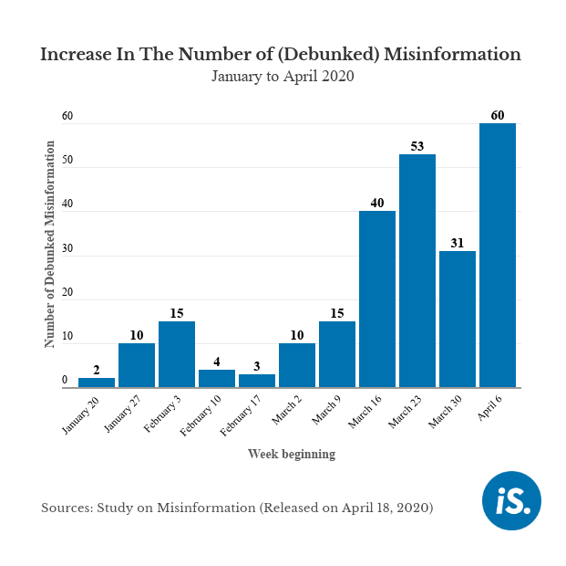
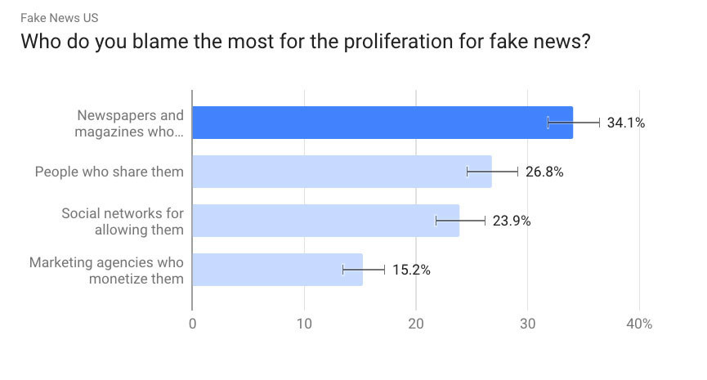
PROBLEM STATEMENT
MOTIVATION
Prevalence of fake news on social media
Emerging research area in Natural Language Processing
Develop a machine learning program to identify fake/unreliable news based on content acquired.

Slide 3
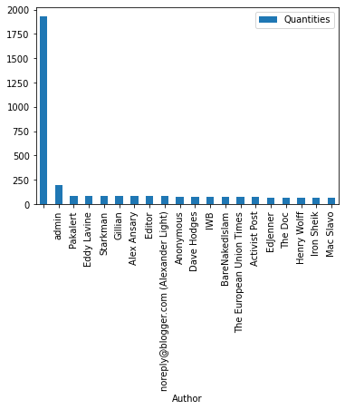
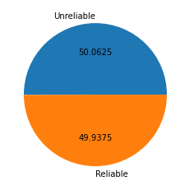
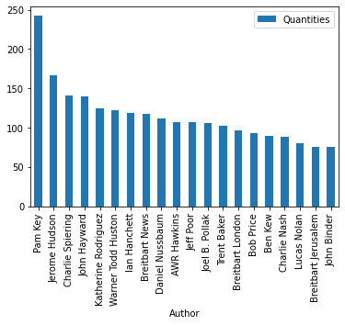
Data-preprocessing & vectorizing the data
UNRELIABLE NEWS AUTHORS
DATA
PREPROCESSING
DATA REDUCTION
DATA TRANSFORMATION
DATA CLEANING
Handling missing data
Dropping observati-ons and variables
Normalisation(stopwords removal,stemming etc.)
Attribute selection
Discretization
Attribute subset selection
Dimensionality reduction
Numerosity reduction
RELIABLE NEWS AUTHORS
Vectorizing Data using TF-IDF Vectorizer

Slide 4
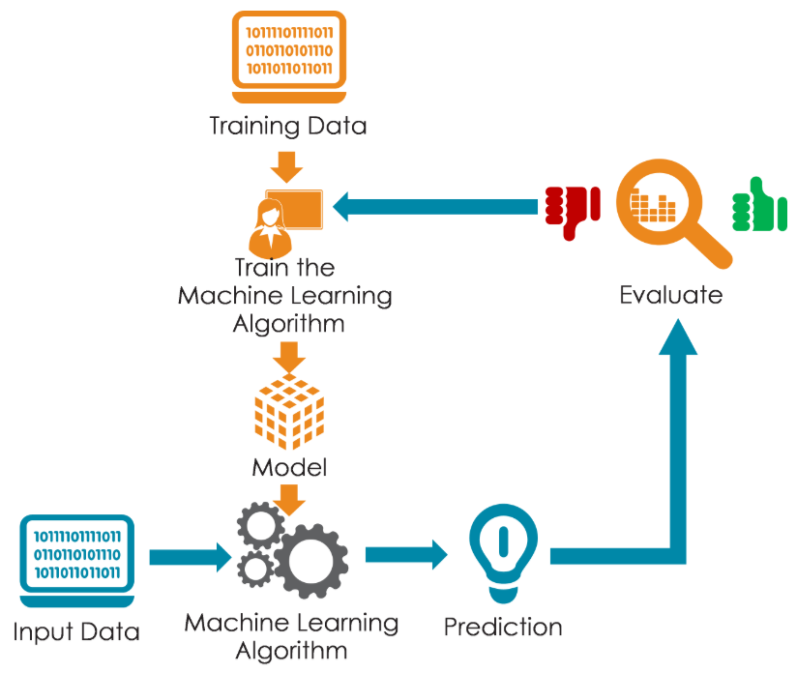
Model selection & Training
Models used
KNN (KNearestNeighbors)
SVM (Static Vector Machine)
Logistic Regresson
AdaBoost
XGBoost
Random Forest
Hyper-parameter Tunning

Slide 5
Models’ comparision
Models | Accuracies
RandomForestClassifier | 81.40%
AdaBoostClassifier | 78.92%
XGBClassifier | 78.51%
SVC | 78%
KNeighborsClassifier | 74.03%
LogisticRegression | 66.44%
The precision of KNeighborClassifiers and Logistic Regression are the same.
And RandomForest Classifiers are the best classifiers among all.

Slide 6
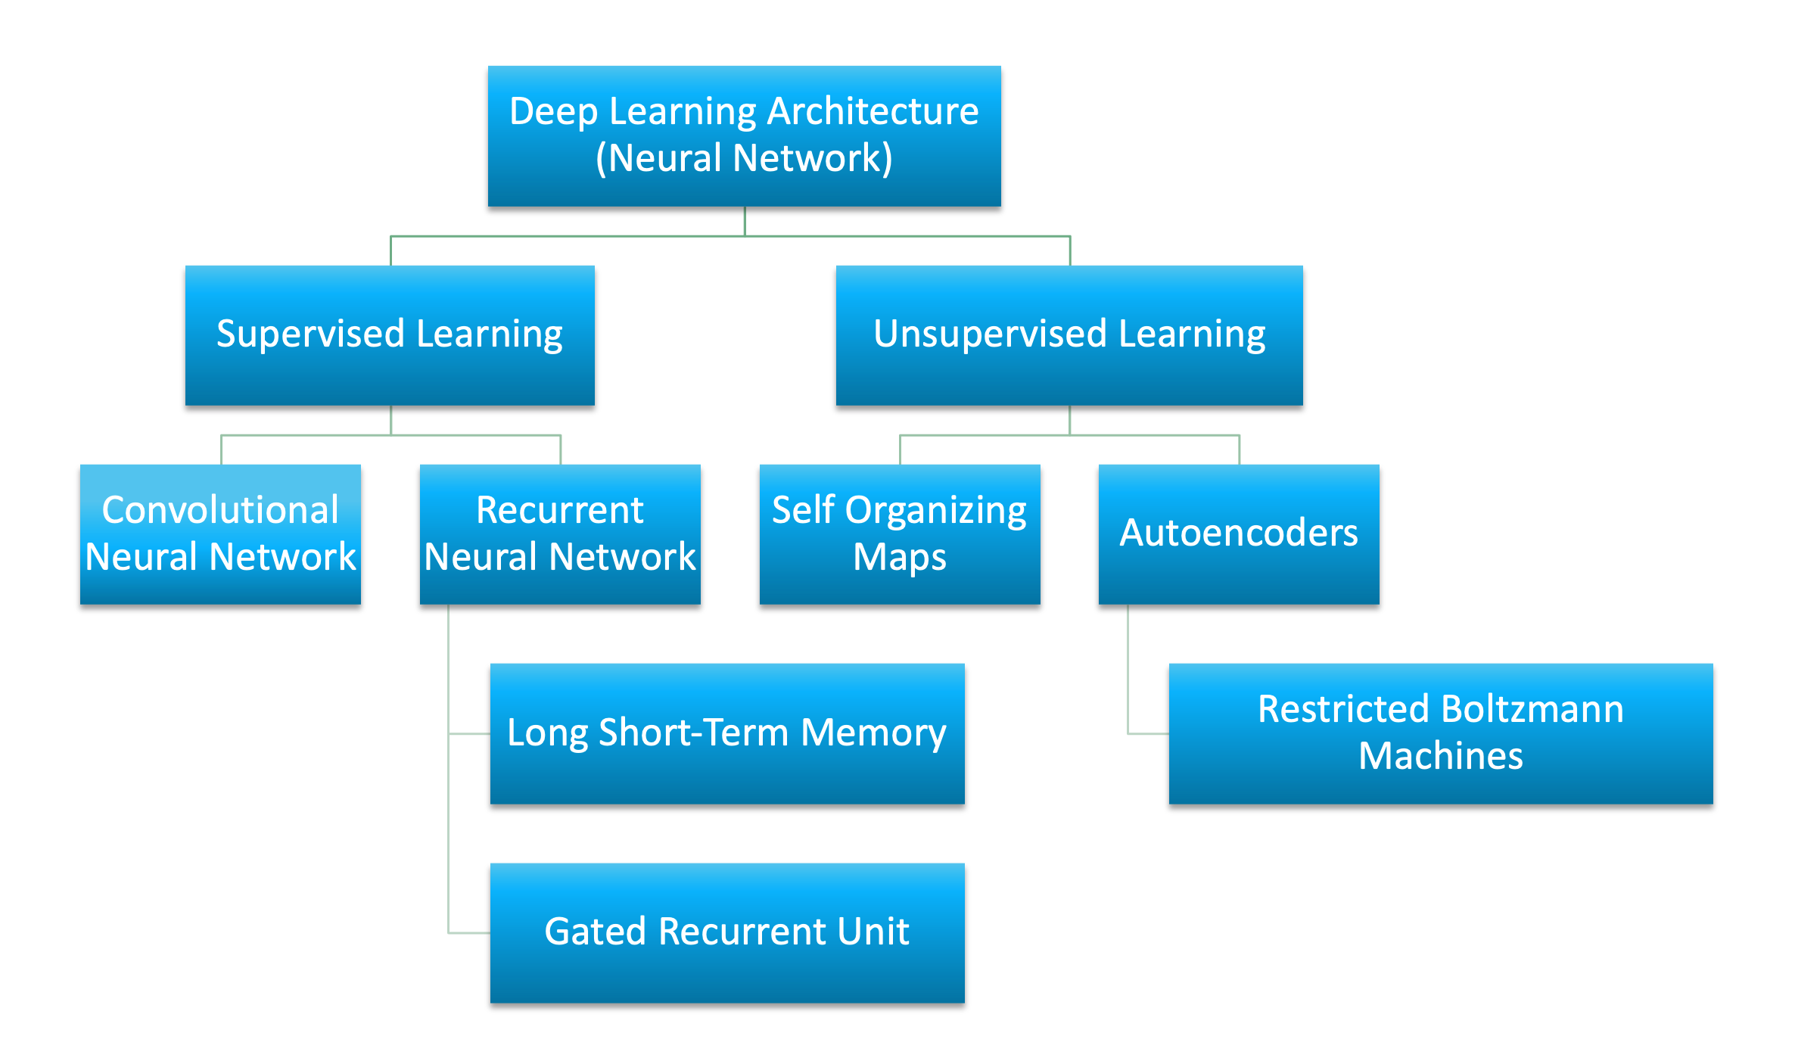
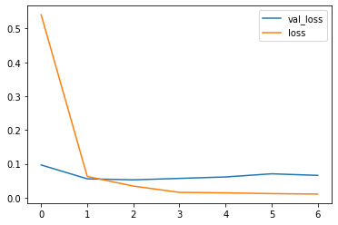
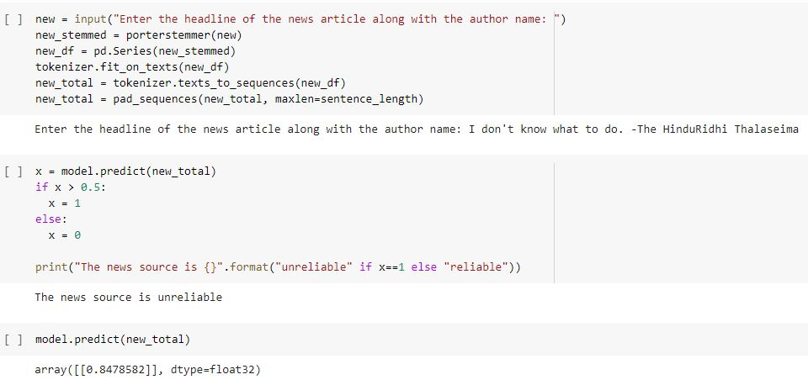
Neural networks
Neural Network | Accuracy | Precision
Keras Classifier | 99.11% | 98.88%
Model Prediction

Slide 7

Future work
N-gram Analysis ( like: Bi-grams,Tri-grams etc.)
Semantic Analysis
Model deployment on cloud

